Slide 1

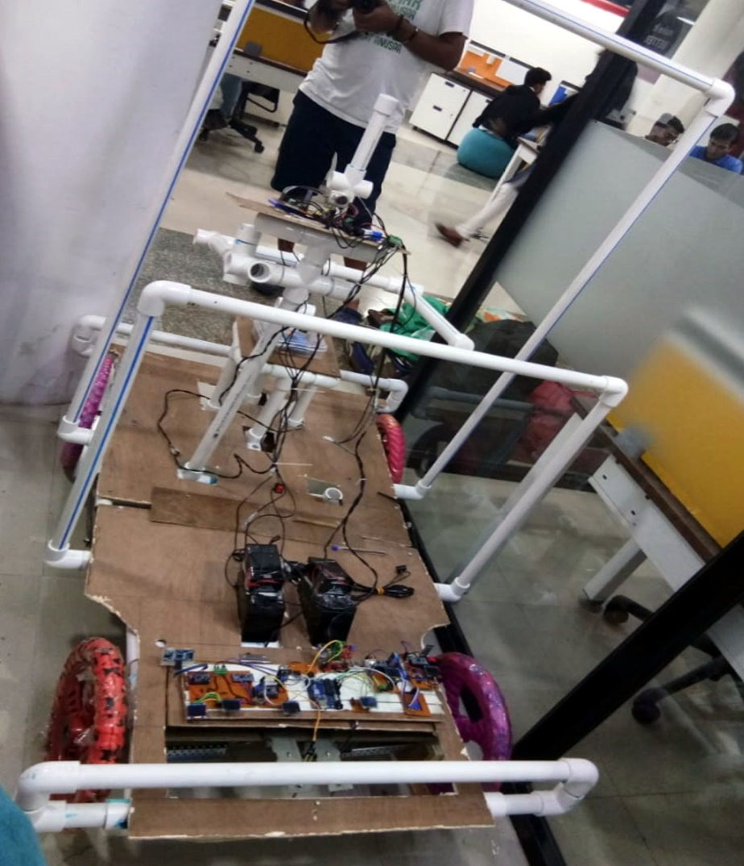

Make Sense Out of Mars
Presented by
TEAM SPECTRA
Team Members:
Aditi
Avishek Biswas
Debam Saha
Wasim Akram

Slide 2
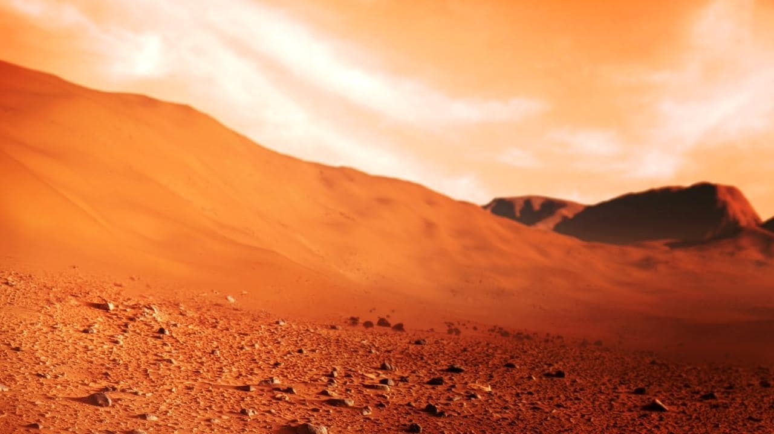

Challenges
Build CLUSTER of SENSOR .
Biomedical life support sensor.
Portable lander

Slide 3
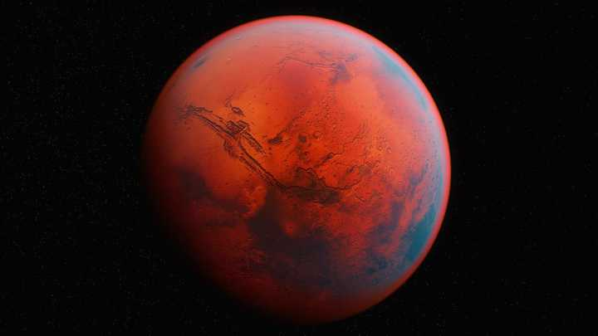

STORY OF OUR PROJECT…

Slide 4
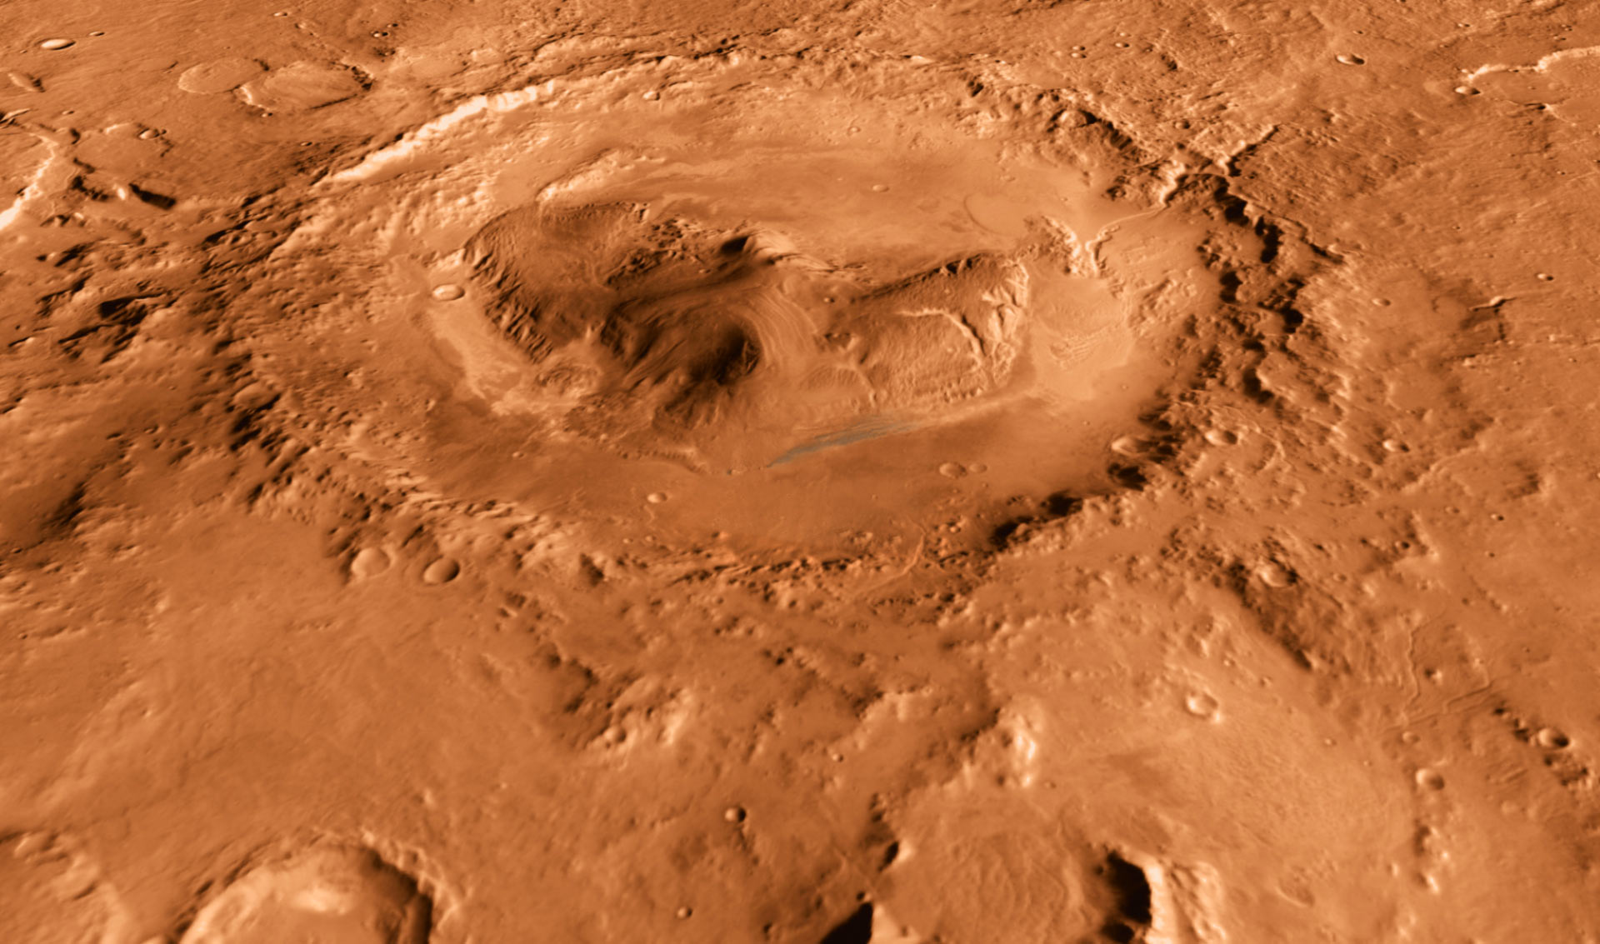
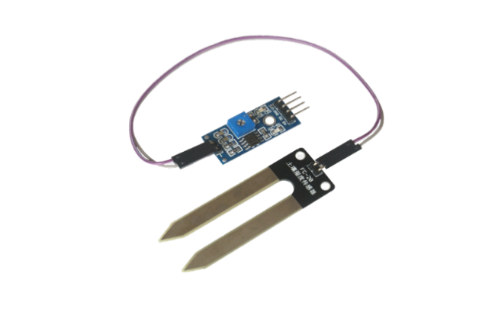
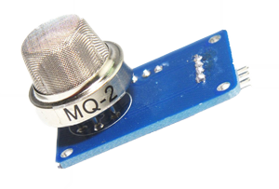
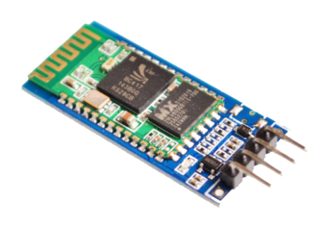

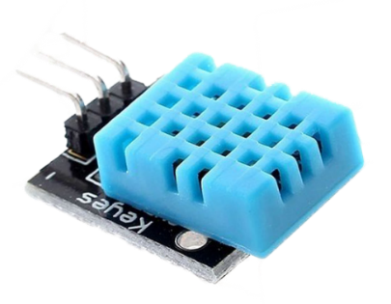
Solutions of Our Idea …….. Cluster of sensor
MQ2 Sensor
Soil Moisture Sensor
HC05 Bluetooth Sensor
DHt11 Sensor

Slide 5
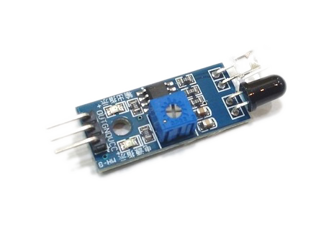
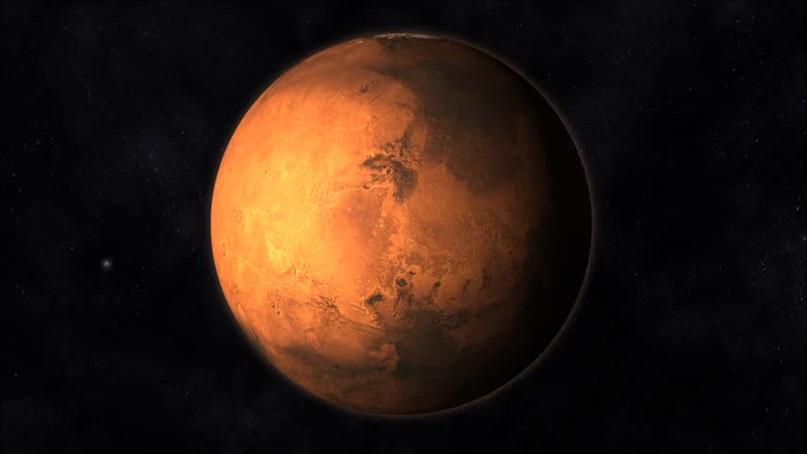
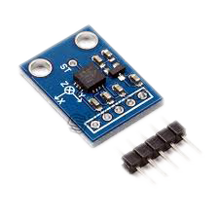
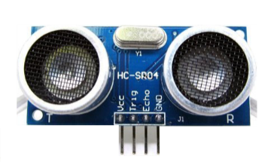
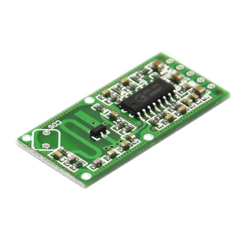
Accelerometer Sensor
IR Sensor
Thinking about more Senses
Sonic Sensor
Microwave Sensor

Slide 6
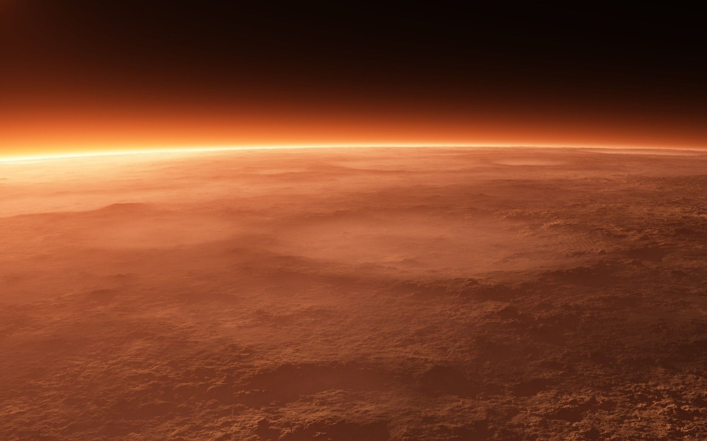
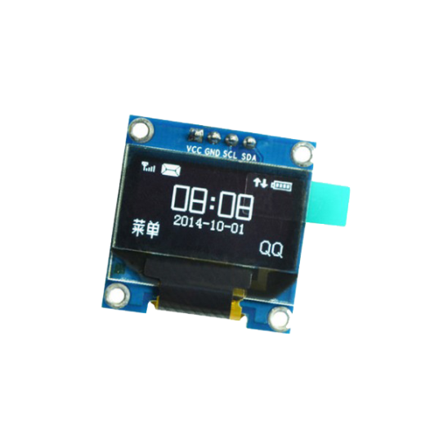
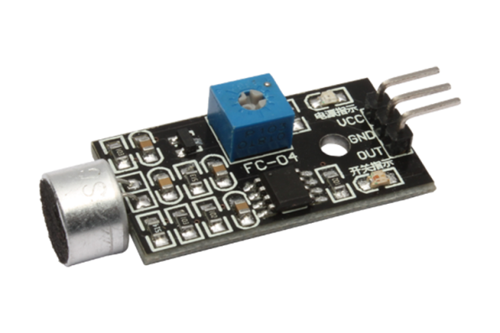
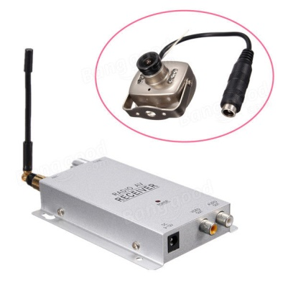
OLED DISPLAY 0.96’’
Sound Sensor
Radio Frequency camera

Slide 7
Gases present in Mars(ppm)
Gases | Present(ppm)
CO2 | 959700
Ar | 19300
N2 | 18900
O2 | 1460
CO | 557
Our Sensor range between 300 – 10,000(ppm) for following gases:
Gases
H | N2
LPG | O2
CH4 | CO2
CO
ALCOHOL
SMOKE
PROPANE

Slide 8
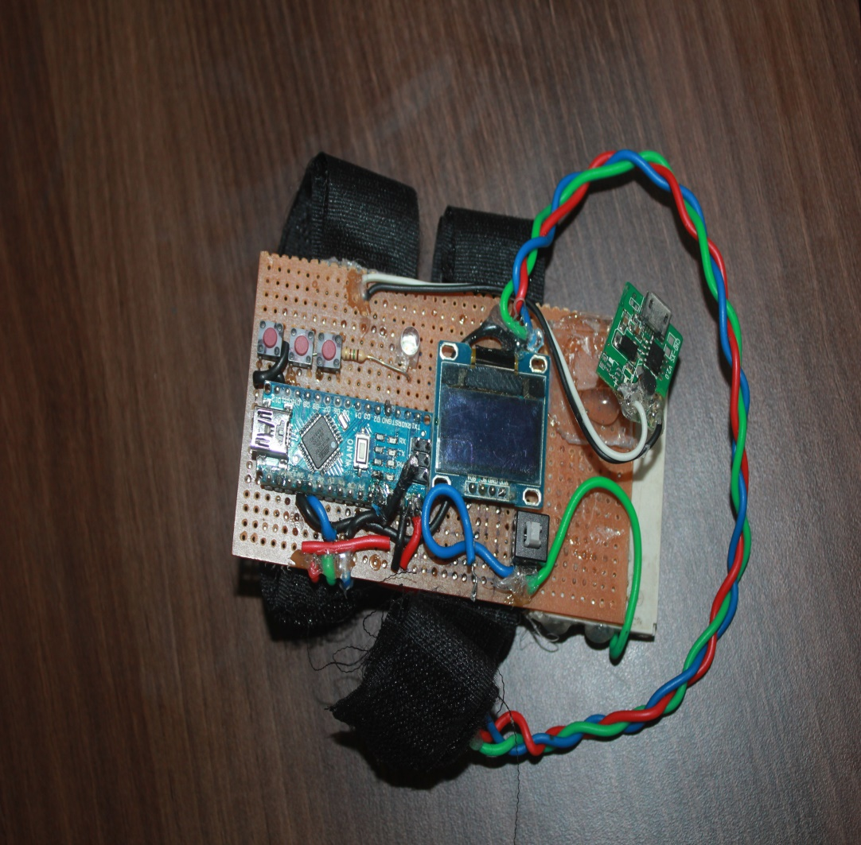
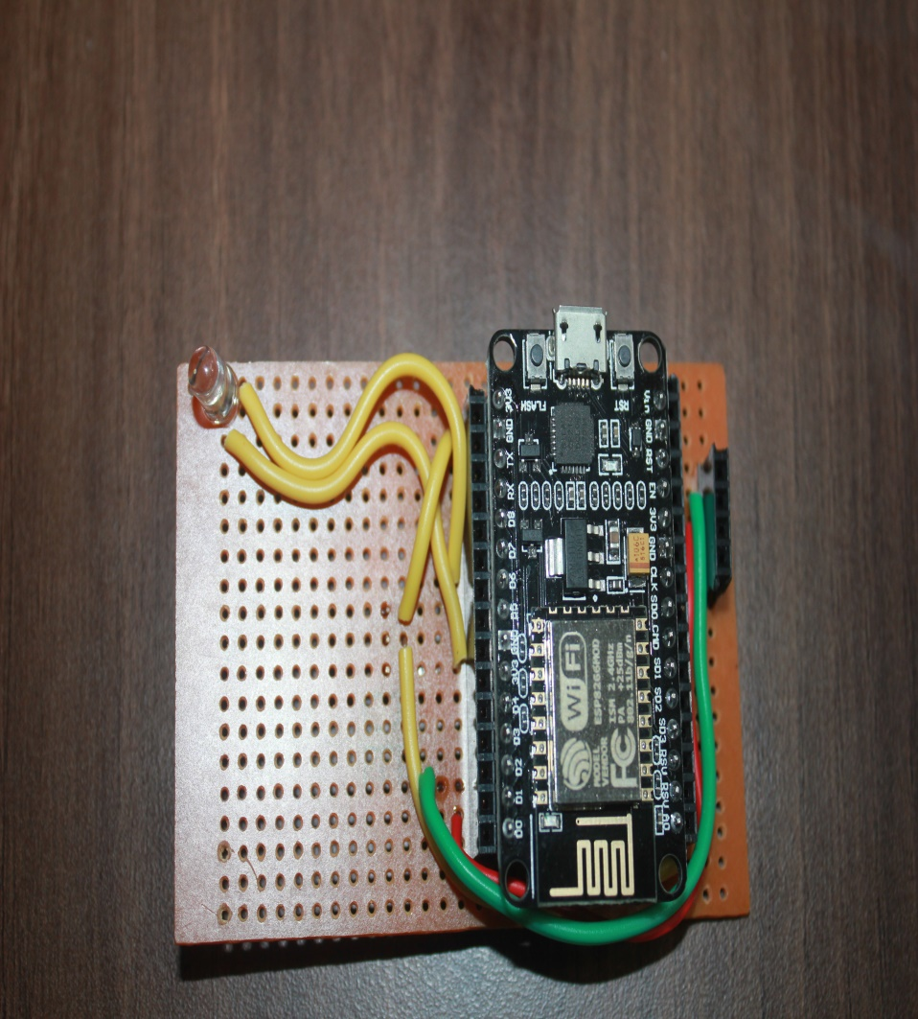
PRE-HACKATHON
PRESENT

Slide 9
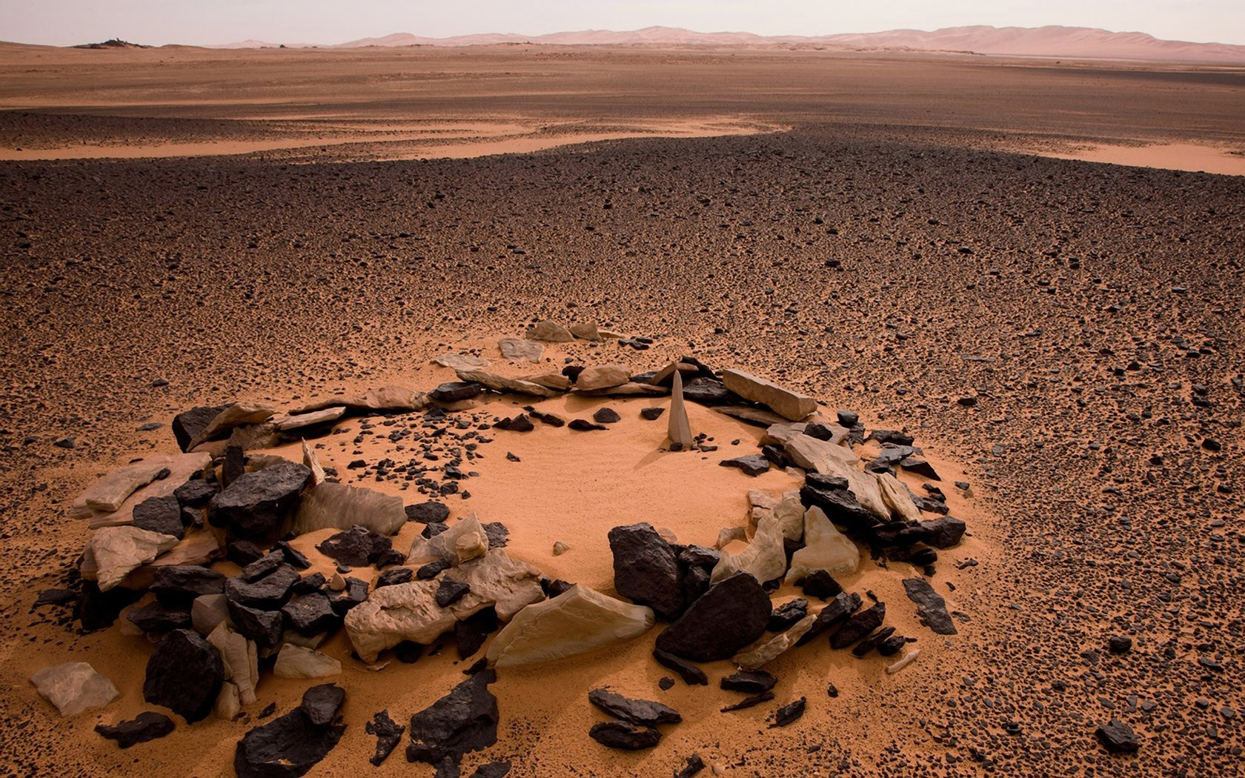
FUTURE SCOPE OF OUR PROJECT
Brief case with more features
Reusing energy of crash landing.
Low cost with more Efficiency.
Enhanced Interface in a “Single Screen”.

Slide 10
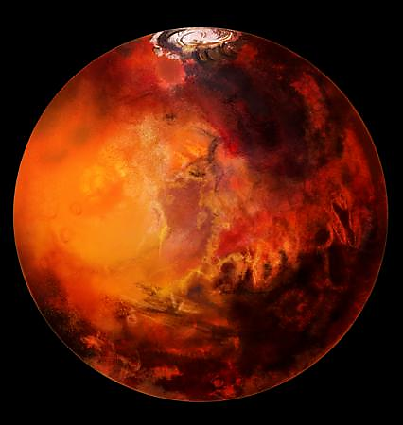
CONCLUSION

Slide 11


